Slide 1
3D Asset Development
Assessment 3
Student Name
CUADES201 Follow a design process
CUARES201 Collect and organise content for broadcast or publication
CUAACD101 Use basic drawing techniques
CUADIG212 Develop digital imaging skills

Slide 2
Pre-Production Documentation

Slide 3
Work Health & Safety
WHS
Maintain Safe Workspace
When working in a studio environment it is important to maintain healthy and safe work practices. Before starting the assessment ensure that the following safe work practices are being maintained by evaluating your work environment using the checklist below.
X
1. The workstation is setup ergonomically:
An ergonomic workstation requires that the position/height and angle of the monitors, chair, keyboard, mouse and desk can be adjusted to maintain a healthy posture and that there is an appropriate level of lighting in the room.
X
2. Regular breaks have been scheduled:
It is important to take regular breaks when working at a computer for an extended period of time.
X
3. The work environment is free of hazards:
Hazards are potential sources of injury or ill-health which may include mechanical, physical, chemical, psychological and electrical hazards.

Slide 4
Pre-Production
Creating the story
Environment Story Synopsis
Isashell is an Island worker at an Island Getaway. She is constantly forced to deal with all the problems no one else wants to fix and must run around like a slave for a racoon who pays her a made-up currency. In this scene Isashell lets out all her pent-up anger with the help of a 12 Gauge A. Thomson Hammer Double Barrel Shotgun.
*All Feedback to be left as COMMENTS

Slide 5
Pre-Production
Documentation
Character Biography
Name | Isashell
Age | 28
Personality | Overworked and Tempered
*All Feedback to be left as COMMENTS

Slide 6
Pre-Production
Documentation
Character Biography
Purpose | To keep the island safe and deal with all the problems that the villagers might have
Needs | A vacation and a foot spa
Wants | To spice up work
*All Feedback to be left as COMMENTS

Slide 7
Pre-Production
Documentation
Asset List
Type a list of Assets in which you WANT and the estimate time of how long it will take you to model, texture. (Duplicate this slide if you have more)
Asset List | Est. Drawings | Est. Modelling | Est. Texturing
Isashell | 30 Mins | 1 Day | 30 Minutes
12 Gauge A. Thomson Hammer Double Barrel Shotgun | 10 Minutes | 1 Hour | 10 Minutes
Plants | 5 Minutes | 30 Minutes | 5 Minutes
12 Gauge Birdshot Shell | 2 Minutes | 20 Minutes | 5 Minutes
Suspicious Racoon | 20 Minutes | 1 Hour | 10 Minutes
Broken Tree Stump | 10 Minutes | 40 Minutes | 10 Minutes
Oak Trees | 10 Minutes | 40 Minutes | 10 Minutes
*All Feedback to be left as COMMENTS

Slide 8
Pre-Production
Documentation
Milestone Schedule
Milestone | Date Due | Feedback (Y or N) | Approved
Synopsis | 8/8/23 | Y | X
Character Biography | 8/8/23 | Y | X
Asset List | 8/8/23 | Y | X
Character Sketches
Environment Sketches

Slide 9
Pre-Production
Documentation
Milestone Schedule
Milestone | Date Due | Feedback (Y or N) | Approved
Character Orthographic
Environment Modelling
Environment Render and Lighting
Character Modelling
Character Render and Lighting

Slide 10
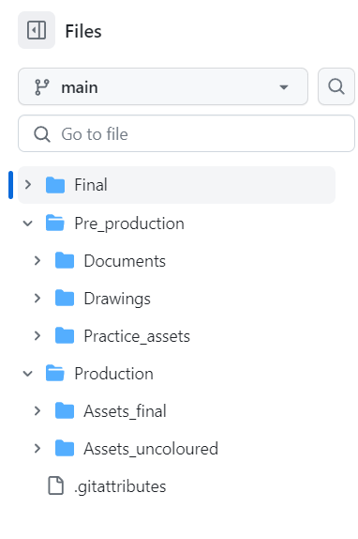
Pre-Production
Folder Structure
Planning the Folders for the project

Slide 11
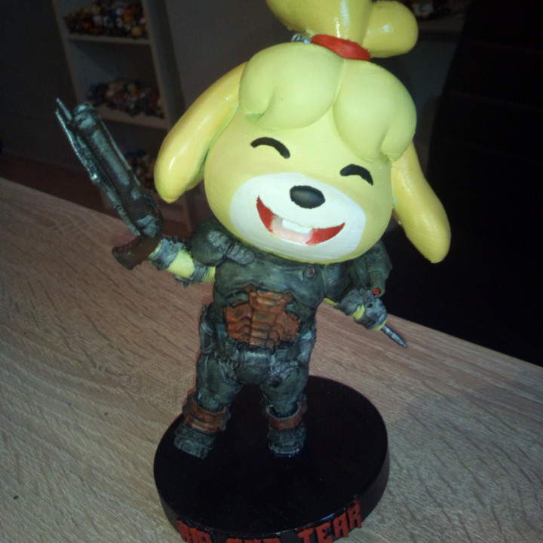
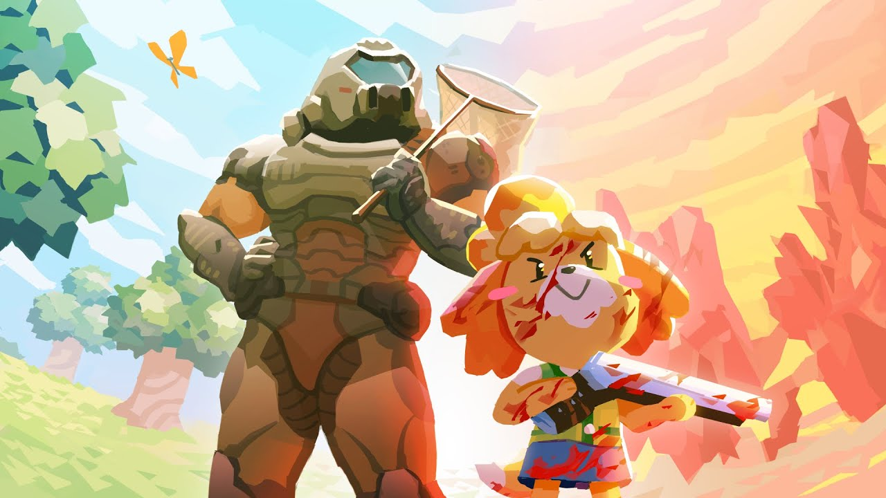
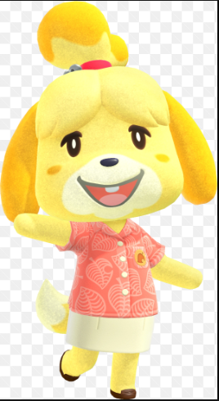
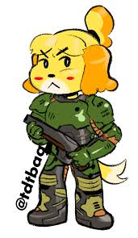
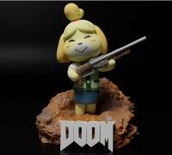
Pre-Production
Image Portfolio
Character Reference
*All Feedback to be left as COMMENTS

Slide 12
Pre-Production
Image Portfolio
Refined Character Reference Board
Upload a Mood Board of your character
*All Feedback to be left as COMMENTS

Slide 13
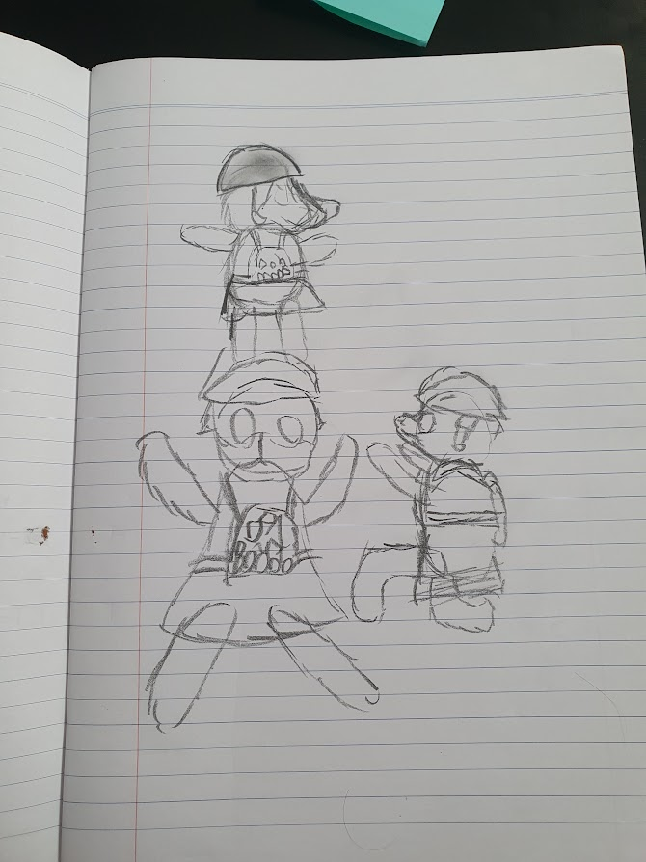
Pre-Production
Image Portfolio
Character Sketches
Upload three different character sketches here (hand drawn)

Slide 14
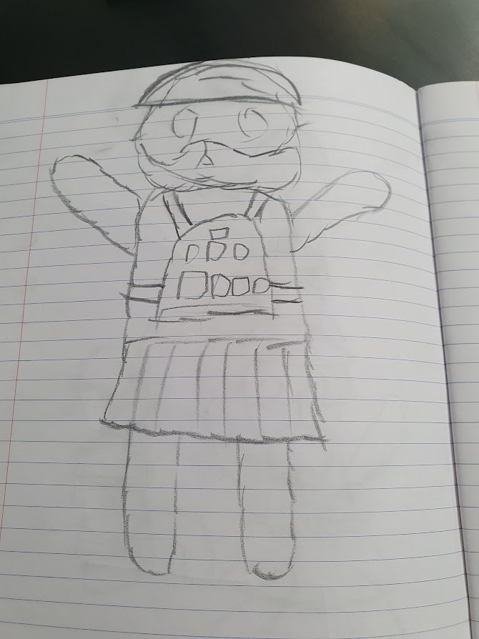
Pre-Production
Image Portfolio
Final Character Concept
Upload final character concept/design here
(Hand Drawn)

Slide 15
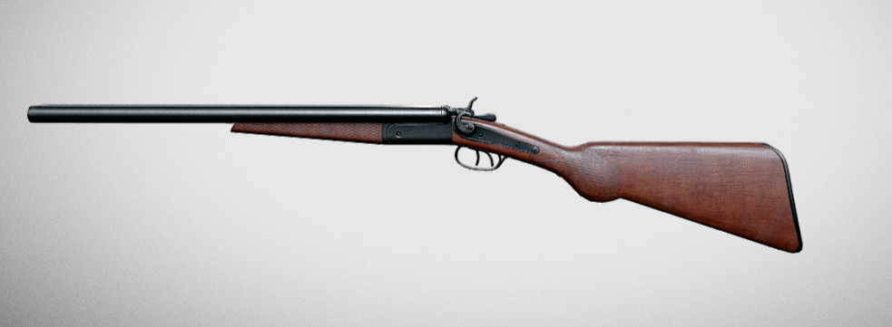
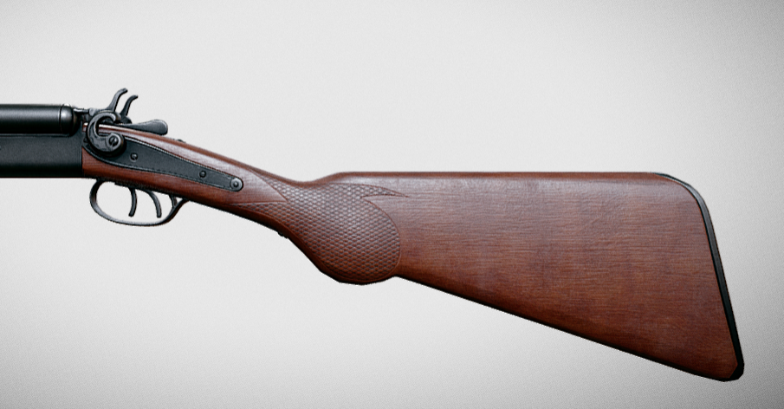
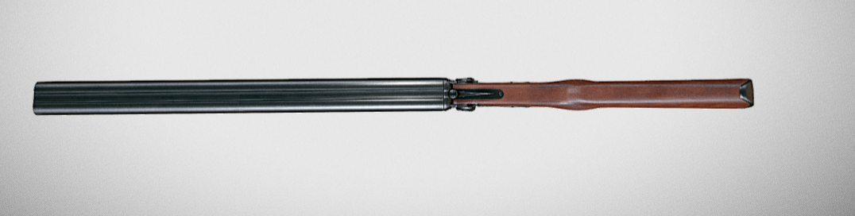
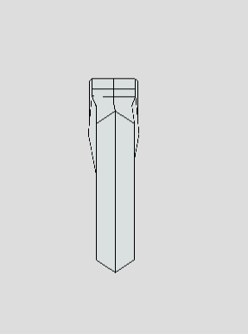
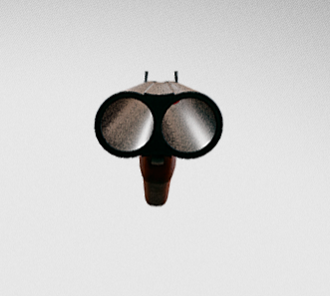
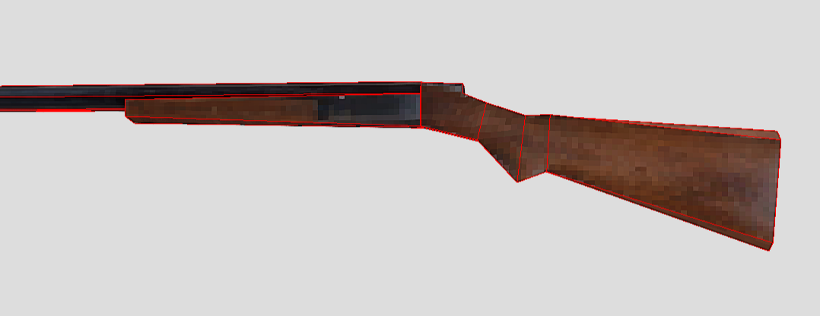
Pre-Production
Image Portfolio
Environment/ Prop Reference
Upload a collection of Environment and Prop reference here
(At least 5 images)
**Note: Use keywords to describe your character to look for those references
*All Feedback to be left as COMMENTS

Slide 16
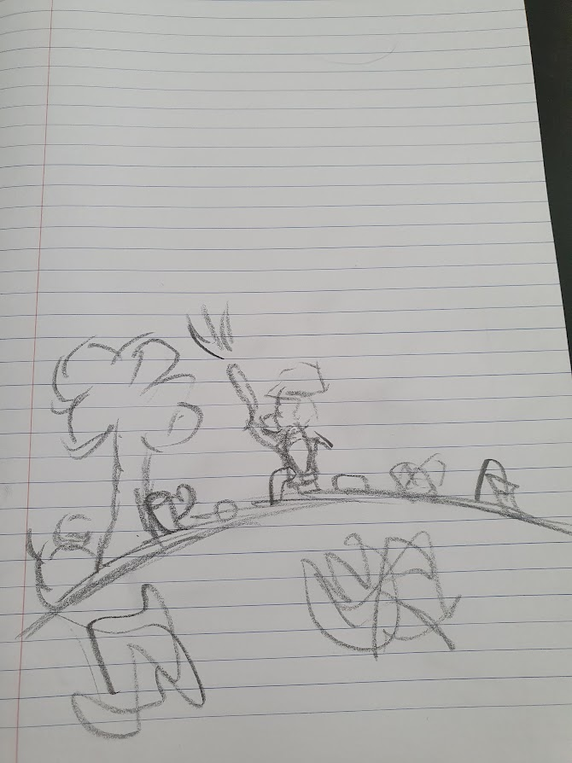
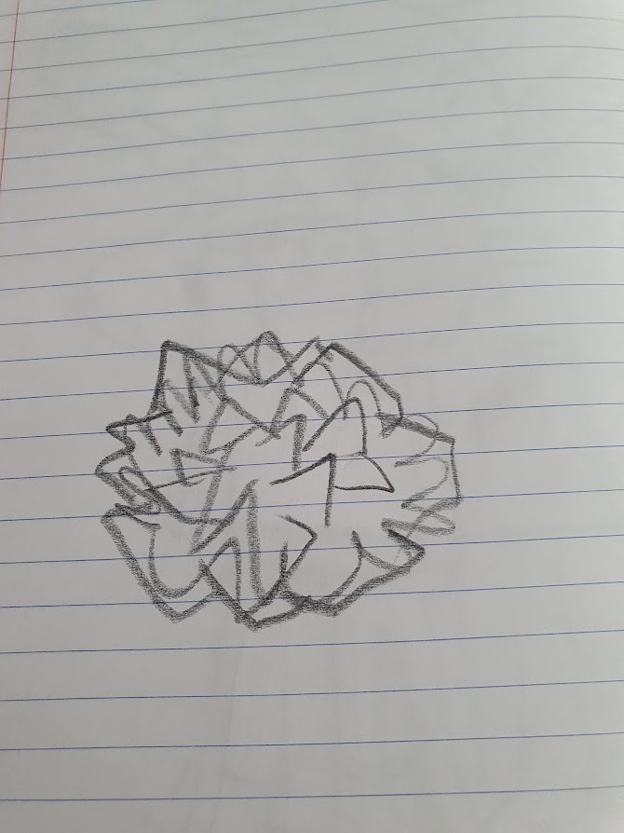
Pre-Production
Image Portfolio
Environment/ Prop concepts
Upload an environment sketch (hand drawn)
Upload a sketch of an asset (hand drawn)

Slide 17
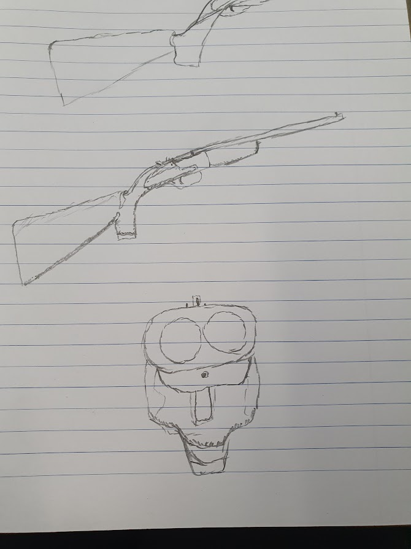
Pre-Production
Image Portfolio
Environment/ Prop Final Design
Upload final Environment and Prop concept/designs here
(Hand Drawn)

Slide 18
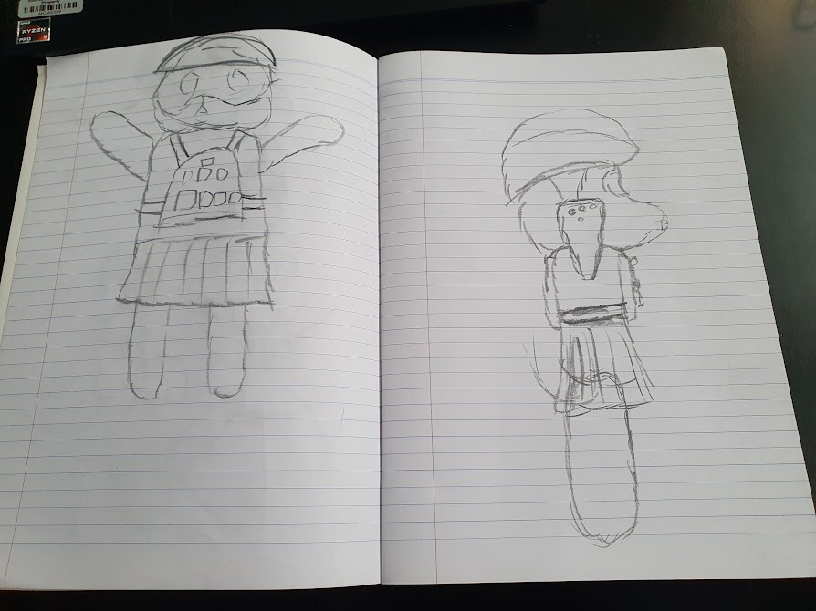
Pre-Production
Image Portfolio
Character Orthographic Drawings
Upload DIGITAL and COLOURED character orthographic drawings here
Front View
Side View
3rd View
(Top or back)

Slide 19
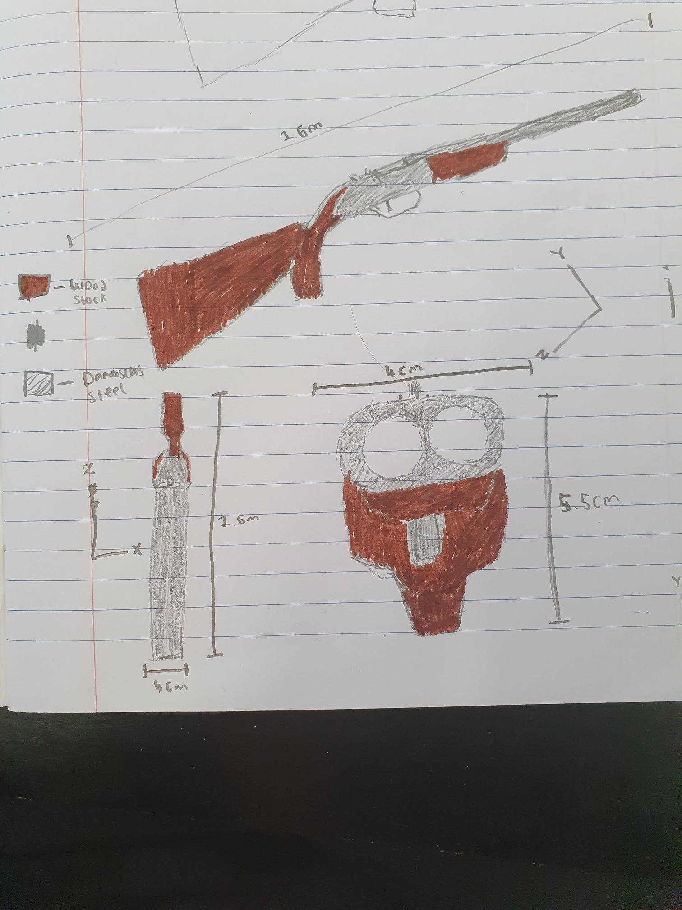
Pre-Production
Image Portfolio
Environment Orthographic Drawings
Upload DIGITAL and COLOURED Environment orthographic drawings here
Front View
Side View
3rd View
(Top or back)

Slide 20
Pre-Production
Documentation
Feedback
Feedback | Approved
I confirm that the concept is my own or does not infringe copyright
Y

Slide 21
Asset Development

Slide 22

Asset Development
Image Portfolio
Character Turnaround
Upload Character Turnaround here
Either playblast, render, or UE4 sample and compose it in a video editing software

Slide 23
Asset Development
Image Portfolio
Character & Environment Lighting & Render
Upload a lit up render of your Character and Environment

Slide 24
Asset Development
Asset development
Feedback
Feedback | Actions taken from feedback | Approved

